Slide 1
Conflict Resolution
Soft Skills
Notes:
Instructor:
Read through the whole lesson (including all the notes) before the day of class
Make note of and gather any supplies you need to bring
Prepare examples, stories
Think through how much time you want to spend on individual activities; make notes
Be sure to allow time to announce the assignment at the end
Overview:
Intro (slides 1-2): 2 minutes
Conflict (slides 3-8 ): 10 minutes minutes
Interventions (slides 9-23): 20-25 minutes
Listening & communication (slides 24-33): 15 minutes
Wrap-up: 2 minutes
Total: 49-54 minutes

Slide 2
Review
Objectives:
Develop a working knowledge of basic project planning and scheduling skills
Learn how to use basic tools
Work breakdown structures
Resource allocation
Gantt charts
Understand the need for tracking managing commitments
Practice time management
Notes:
Objectives from lesson 17

Slide 3
Today’s Objectives
Understand conflicts that affect work teams
Learn strategies for conflict management
Practice proactive listening

Slide 4
Conflicts
ACME Seminar
Notes:
Overview:
Intro (slides 1-2): 2 minutes
Conflict (slides 3-8 ): 10 minutes minutes
Interventions (slides 9-23): 20-25 minutes
Listening & communication (slides 24-33): 15 minutes
Wrap-up: 2 minutes
Total: 49-54 minutes

Slide 5

Notes:
Video: https://www.youtube.com/watch?v=s3umh1bjvgQ
May take several seconds to load
Video is about 1 minute

Slide 6
Discuss
Think of a time you experienced team conflict. Share the experience with a partner.
Describe the conflict.
How did it affect team members?
How was it handled?
How did the resolution affect team members?
Notes:
Give each person about 2 minutes to share (5 minutes total to think and discuss)
Content: www.enme.umd.edu/labs/BESTEAMS/SlidesAdvancedInterpersonal.ppt

Slide 7

Reflect
Why practice conflict management?
Some conflict is inevitable when working in teams.
That said, feuding team members can derail a project
Notes:
Image from https://en.wikipedia.org/wiki/Karnak#/media/File:Karnakpanorama.jpg

Slide 8
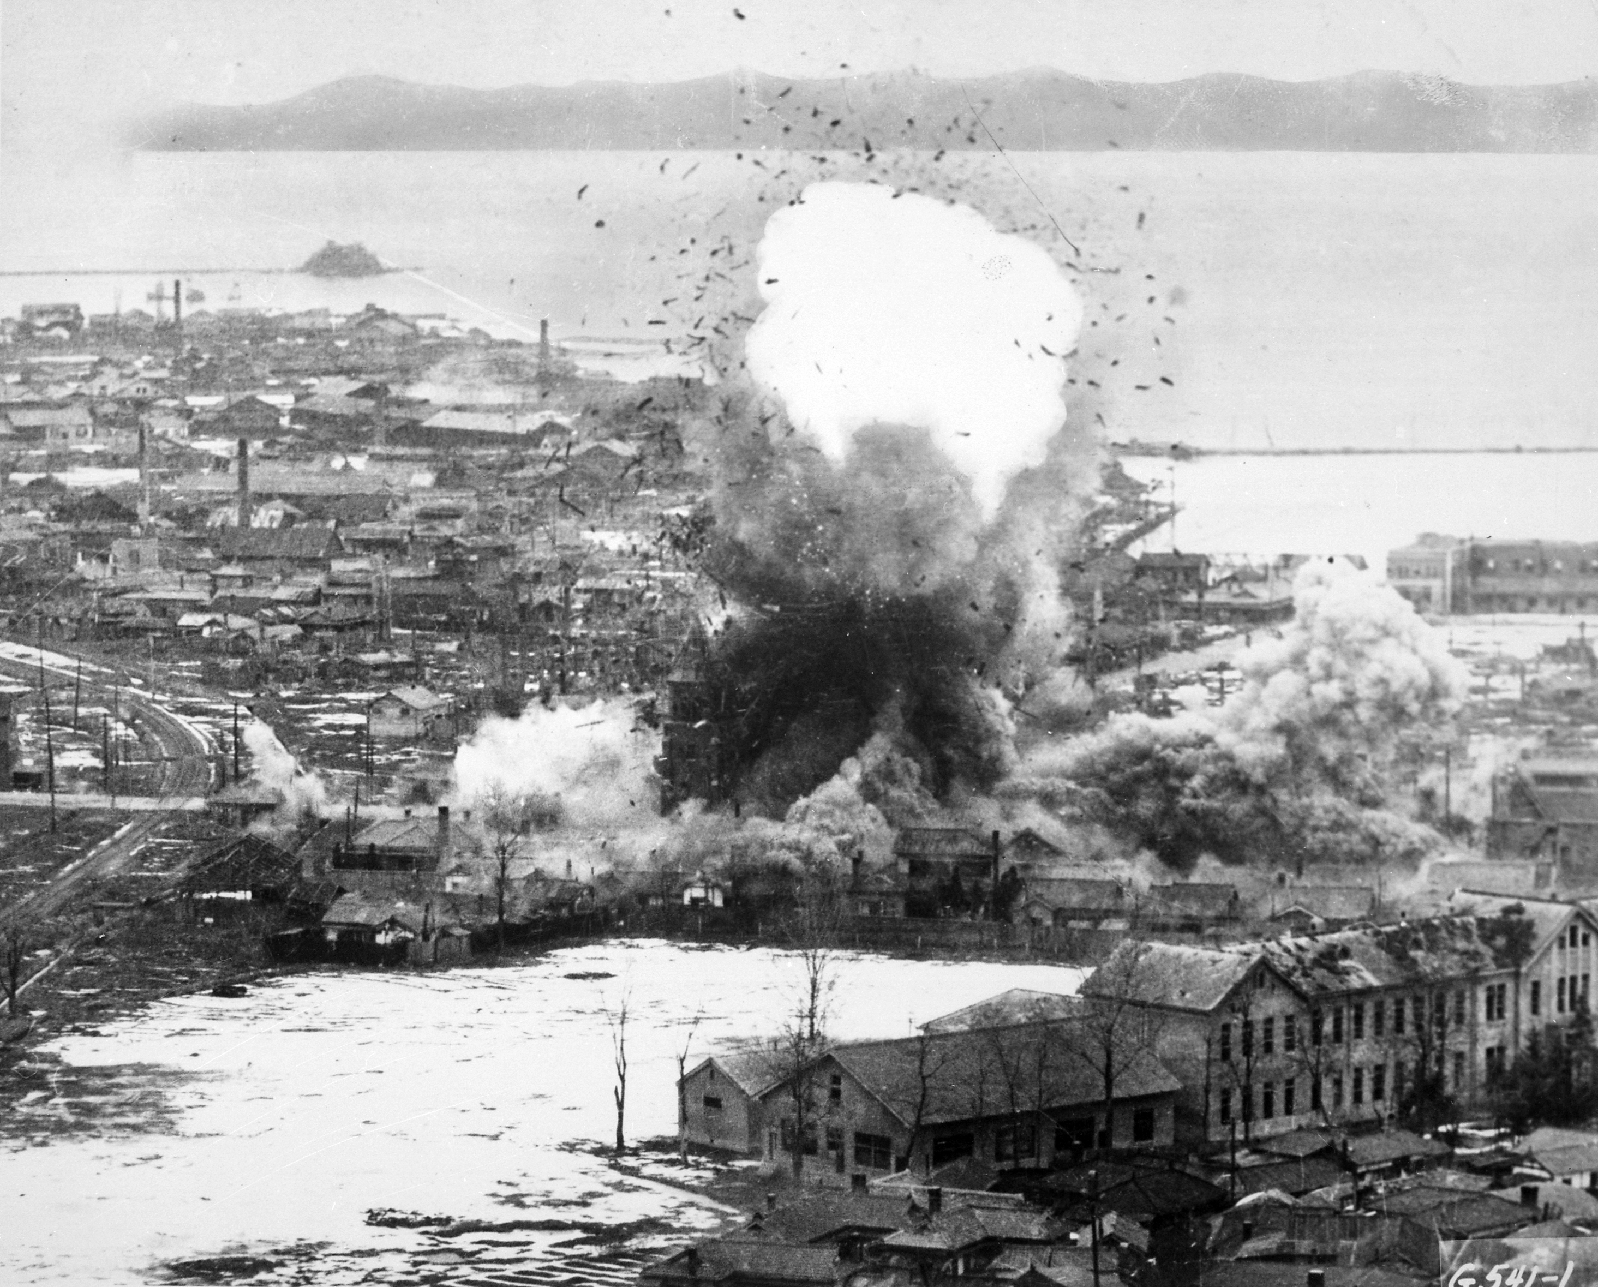
Escalation
When all parties are interested in being right or proving a point, conflict can quickly escalate.
Notes:
Source: https://en.wikipedia.org/wiki/Korean_War

Slide 9
Conventional Responses
Silence, withdrawal
Denial
Dominance
Suppression
Placation
How well do these approaches work?
Notes:
Teacher: Call on class members to share a couple examples, or share your own.
Content: www.enme.umd.edu/labs/BESTEAMS/SlidesAdvancedInterpersonal.ppt

Slide 10
Approaches & Interventions
ACME Seminar
Notes:
Overview:
Intro (slides 1-2): 2 minutes
Conflict (slides 3-8 ): 10 minutes minutes
Interventions (slides 9-23): 20-25 minutes
Listening & communication (slides 24-33): 15 minutes
Wrap-up: 2 minutes
Total: 49-54 minutes

Slide 11
Instructor:
For each of the 5 approaches, introduce the approach, then (if you have time) discuss when this approach would be useful and when it might be harmful.
Decide ahead of time how long you’ll spend on each approach (maybe 2 minutes/approach)
You may want to think of examples ahead of time. They could be from work, school, or personal relationships.

Slide 12

Conflict Management Approaches
1. Accommodating: give the other side what it wants.
Use: when stakes are low or you want to keep the peace
Notes:
Source: http://smallbusiness.chron.com/5-conflict-management-strategies-16131.html
Image: https://static.pexels.com/photos/5122/food-healthy-man-person.jpeg

Slide 13

Conflict Management Approaches
2. Avoiding: ignore the conflict and hope it goes away
Sometimes walking away allows people to calm down and think things through
Most problems don’t go away on their own
Notes:
Source: http://smallbusiness.chron.com/5-conflict-management-strategies-16131.html
Image: https://www.pexels.com/photo/person-in-blue-denim-fitted-jeans-walking-through-hallway-104809/

Slide 14

Conflict Management Approaches
3. Collaborating: find a solution everyone accepts
Use for important decisions that affect everyone
Too time consuming to use for small decisions
Notes:
Content: http://smallbusiness.chron.com/5-conflict-management-strategies-16131.html
Image: https://www.pexels.com/photo/woman-in-gray-shirt-seating-in-between-woman-in-blue-black-and-white-plaid-long-sleeve-shirt-and-man-in-blue-white-and-black-plaid-long-sleeve-shirt-having-conversation-57825/

Slide 15
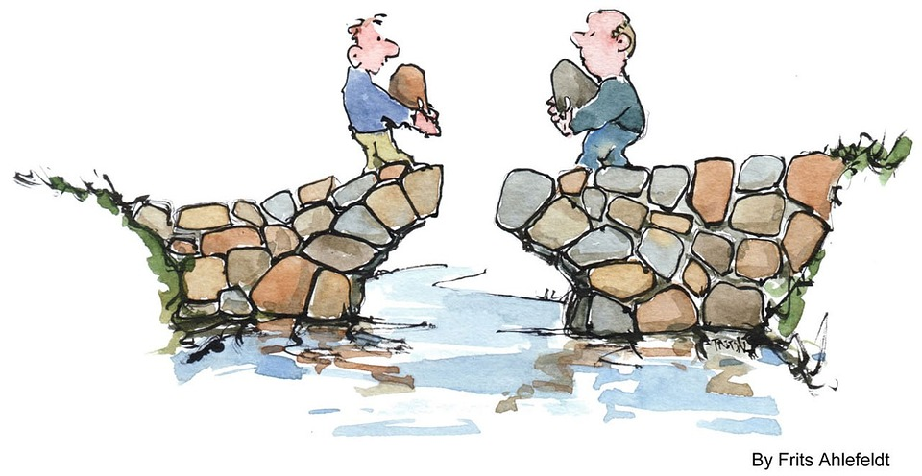
Conflict Management Approaches
4. Compromise: both sides give up something to obtain a mutually acceptable solution
Use when parties hold equal power
Notes:
Source: http://smallbusiness.chron.com/5-conflict-management-strategies-16131.html
Image: https://pixabay.com/en/communication-bridge-people-life-73331/ (CC0 license)

Slide 16
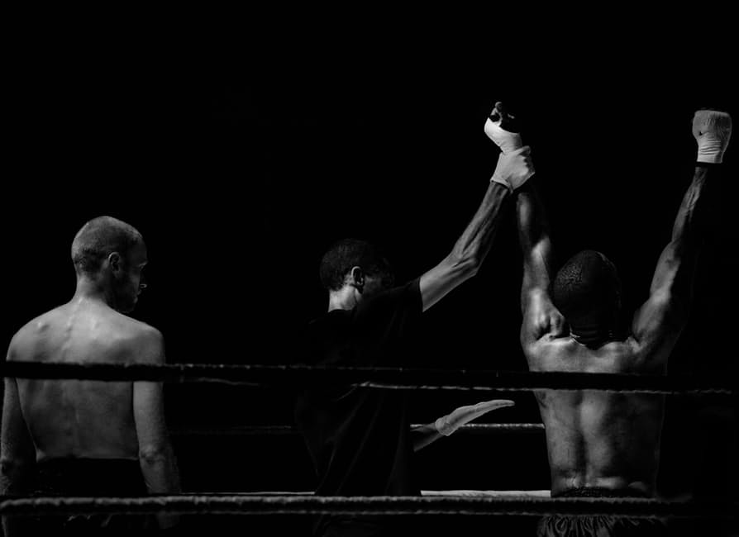
Conflict Management Approaches
5. Competing: one side wins, the other loses
Works in an emergency
Tends to generate ill-will
Notes:
Source: http://smallbusiness.chron.com/5-conflict-management-strategies-16131.html
Image: https://www.pexels.com/photo/black-and-white-sport-fight-boxer-3797/

Slide 17
Interventions
The purpose of intervening is to
disrupt conflict
get the project back on track
Notes:
Content: www.enme.umd.edu/labs/BESTEAMS/SlidesAdvancedInterpersonal.ppt

Slide 18
XYZ Model
When you do X,
in situation Y
I feel Z.
Notes:
Source: http://www.uwyo.edu/fcs/faculty-staff/weigel/life/individual-growth/fact-sheets/conflict-resolution.html

Slide 19
Example
When you criticize my ideas
in front of the whole team
I feel attacked.

Slide 20
Practice
Scenario: Jill and Ted are working on a project together to create a new product. Despite working 60-hour weeks, Jill has missed 3 deadlines, which has put Ted behind too.
Pair up—one of you play Jill, one of you play Ted (or choose different names). Use XYZ statements to explain to each other how you feel. Then try to come up with a solution.

Slide 21
Discuss
How did that go?
What did you like or not like about using XYZ statements?
Were you able to resolve the conflict?
What sort of solution did you achieve?
Notes:
On the next slide is a video that suggests an approach for conflict resolution. Afterward we’ll discuss strategies presented in the video—you may want to take notes.

Slide 22
Notes:
Video: https://www.youtube.com/watch?v=QLbGHQo4qnA

Slide 23
Discuss
On the board, list strategies suggested in the video for resolving conflict.
When have you seen one of these strategies work?
Can you think of an example when these strategies failed?

Slide 24
Interest-Based Relational Approach
Make relationships a priority—treat each person with respect
Separate people from problems—talk about the issues, don’t attack people
Listen carefully to understand the other point of view
Listen first, talk second. You may change your mind after hearing the other side.
Set out the facts.
Explore options together.
Notes:
If you’re short on time, you could skip this slide (or use this slide instead of the video in slide 21).
Source: https://www.mindtools.com/pages/article/newLDR_81.htm

Slide 25
Listening & Communication
ACME Seminar
Notes:
Overview:
Intro (slides 1-2): 2 minutes
Conflict (slides 3-8 ): 10 minutes minutes
Interventions (slides 9-23): 20-25 minutes
Listening & communication (slides 24-33): 15 minutes
Wrap-up: 2 minutes
Total: 49-54 minutes

Slide 26

Listening
To resolve conflict, listening is often more important than speaking
Notes:
Image: https://www.pexels.com/photo/girls-women-laughing-secret-29593/

Slide 27

Reactive listening
Allows pre-conceived notions to color interactions
Test for reactive listening: Are you coming to the negotiation with a fixed viewpoint? Is there only one acceptable outcome?
Notes:
Image: https://pixabay.com/en/conversation-talk-talking-people-799448/
Content: www.enme.umd.edu/labs/BESTEAMS/SlidesAdvancedInterpersonal.ppt

Slide 28
Exercise: Reactive listening
Pair up
One of you (A) picks a project that you’re excited about and describes it for your partner. (1 minute)
The partner (B) will listen from a “reactive” place. Interact as though you already know about what your partner is sharing. Let your preconceived notions color your thinking.
Switch positions (the listener becomes the sharer).
Notes:
If you’re running out of time, skip this activity. (More important to practice proactive listening)
If needed, the facilitator can be in a pair with someone. Otherwise, circulate and butt in as a reactive listener.
Content: www.enme.umd.edu/labs/BESTEAMS/SlidesAdvancedInterpersonal.ppt

Slide 29

Class Discussion
What was it like to share something you’re excited about with someone who listens reactively?
What was it like to listen reactively?
Notes:
Image: https://www.google.com/search?q=talking&biw=685&bih=411&source=lnms&tbm=isch&sa=X&ved=0ahUKEwiL5q-U-6vRAhXkgVQKHbR8ATUQ_AUIBigB#tbs=sur:fc&tbm=isch&q=two+unhappy+people+&imgrc=ik_JMn_w4zbeuM%3A

Slide 30
Proactive Listening
Listen for possibilities and partial solutions to the problem
Try to appreciate the other person and their point-of-view.
Why would other members hold fast to certain positions and not compromise?
What are your unshakeable positions and why do you hold them?
Notes:
Content: www.enme.umd.edu/labs/BESTEAMS/SlidesAdvancedInterpersonal.ppt

Slide 31
Exercise: Proactive listening
Pair up
One of you (A) picks a project that you’re excited about and describes it for your partner. (1 minute)
The partner (B) will listen from a “proactive” place. Try to learn something you didn’t know before, or gain appreciation for the other person.
Switch positions (the listener becomes the sharer).
Notes:
If needed, the facilitator can be in a pair with someone. Otherwise, circulate and butt in as a reactive listener.
Content: www.enme.umd.edu/labs/BESTEAMS/SlidesAdvancedInterpersonal.ppt

Slide 32

Class Discussion
What was it like to share something you’re excited about with someone who listens proactively?
What was it like to listen proactively?
Notes:
Image: https://www.pexels.com/photo/rear-view-of-woman-using-mobile-phone-in-farm-247811/

Slide 33
Reflect
What are your strengths as a listener?
How might you listen better?

Slide 34

Take-away
Practice proactive listening to help resolve conflict
Notes:
Image from https://www.pexels.com/photo/women-sisters-friends-young-42389/

Slide 35
Outcomes
Understand conflicts that affect work teams
Learn strategies for conflict management
Practice proactive listening

Slide 36
Resources
Osland, J.S., Kolb, D.A., & Rubin, I. M. (2001) The Organizational Behavior Reader (7th ed.). Englewood Cliffs, NJ: Prentice Hall.
Osland, J.S., Kolb, D.A., & Rubin, I.M. (2001). Organizational Behavior (7th ed.). Englewood Cliffs, NJ: Prentice Hall.
http://nadabs.tripod.com/team/conflictguide.html
http://ecu3.msh.org/quality/ittools/itnegot.cfm
Crucial Conversations: https://youtu.be/PuJgqTs-G44
https://www.mindtools.com/pages/article/newLDR_81.htm
www.enme.umd.edu/labs/BESTEAMS/SlidesAdvancedInterpersonal.ppt

Slide 37
Content (not images or videos) copyright information:

